Slide 1
SBA Disaster Assistance Loans Due To Losses From The Civil Unrest In Minnesota
August 12, 2020

Slide 2
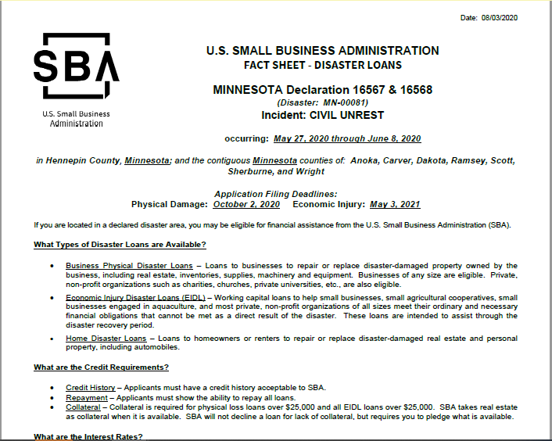
SBA Administrative (Agency) Declaration
8-12-20

Slide 3
SBA Loan Requirements
Requirements for loan approval:
Eligibility - damaged property must be in a declared county.
Credit History - Applicants must have a credit history acceptable to SBA.
Repayment - Applicants must show the ability to repay all loans.
8-12-20

Slide 4
SBA’s Disaster Loan Program
The law gives SBA several powerful tools to make disaster loans affordable:
Low interest rates
Long terms (15 or 30 years)
Refinancing of prior debts (in some cases)
Filing Deadline for Physical Damage: 60 days from the declaration date.
Filing Deadline for Economic Injury: 9 months from the declaration date.
8-12-20

Slide 5
Collateral Requirements
Physical loans over $25,000 require collateral.
Economic injury loans over $25,000 require collateral.
(Up to $50,000 unsecured disaster business loans - combined physical and economic injury loan funds).
SBA will not decline a loan for lack of collateral, but requires collateral that is available.
8-12-20

Slide 6
SBA Disaster Loan Limits
Types of Loans | Borrowers | Purpose | Max. Amount
Business Loans | Businesses and private nonprofits | Repair or replace real estate, inventory, equipment, etc. | $2 million *
Economic Injury Loans | Small businesses and private nonprofits | Working capital loans | $2 million *
Home Loans | Homeowners | Repair or replace primary residence | $200,000
Home Loans | Homeowners and renters | Repair or replace personal property | $40,000
Mitigation | Businesses, private nonprofits and homeowners | Mitigate / prevent future loss of the same type | 20% of verified physical damage. Homeowners limited to $200,000
*The maximum business loan is $2 million, unless the business qualifies as a Major Source of Employment (MSE).
8-12-20

Slide 7
Step 1
Step 2
Step 3
Step 1: Apply for an SBA Loan
Apply:
Online at SBA’s secured website: https://disasterloan.sba.gov/ela
Call the Virtual Disaster Loan Outreach Center
By mail
8-12-20

Slide 8
Step 1
Step 2
Step 3
Step Two: Property Verification and Loan Processing
SBA will contact applicant to verify damage.
SBA will process the file to a decision.
Could take up to 2-3 weeks
If approved, loan documents are forwarded to borrower. The applicant is advised of appeal rights, if declined.
8-12-20

Slide 9
Step Three: Loan Closing and Disbursement
Step 1
Step 2
Step 3
An initial disbursement is generally made within 5 days after the applicant signs and returns the required loan closing documents.
Up to $25,000 for physical damages
Up to $25,000 for economic injury
Subsequent disbursements are generally made in installments to match the pace of construction.
8-12-20

Slide 10
SBA’s Economic Injury Disaster Loans
What businesses are eligible to apply?
SBA’s Economic Injury Disaster Loans (or working capital loans) are available to small businesses, small agricultural cooperatives, small aquaculture businesses and most private non-profit organizations
This includes:
Businesses directly affected by the disaster
Businesses that offer services directly related to the businesses targeted in the declaration
Other businesses indirectly related the industry that are likely to be harmed by losses in their community
8-12-20
10

Slide 11
SBA Economic Injury Disaster Loans (EIDLs) The Basics
Small businesses in a declared disaster area that have suffered substantial economic injury, may be eligible for an EIDL, even if they do not have any physical damage.
Substantial economic injury means the business is unable to meet its obligations and to pay its ordinary and necessary operating expenses.
EIDLs provide the necessary working capital to help small businesses until normal operations resume.
8-12-20

Slide 12
SBA’s Economic Injury Disaster Loans These low-interest loans can:
Help meet working capital needs caused by the declared disaster
Help pay financial obligations and operating expenses which could have been paid had the disaster not occurred, i.e.,
Fixed debt payments, payroll, accounts payable, etc.
Extraordinary expenses caused by the disaster
EIDLs do not replace lost revenue, lost profits or fund expansion
8-12-20

Slide 13
SBA’s Disaster Loans are Different from Other SBA Loans
SBA’s Economic Injury Disaster Loan (EIDLs) funds come directly from the U.S. Treasury.
Applicants do not go through a bank to apply. Instead apply directly to SBA’s Disaster Assistance Program at: DisasterLoan.sba.gov
There is no cost to apply.
There is no obligation to take the loan if offered.
The maximum unsecured loan amount is $25,000.
Applicants can have an existing SBA Disaster Loan and still qualify for a loan for this disaster, but the loans cannot be consolidated.
8-12-20

Slide 14
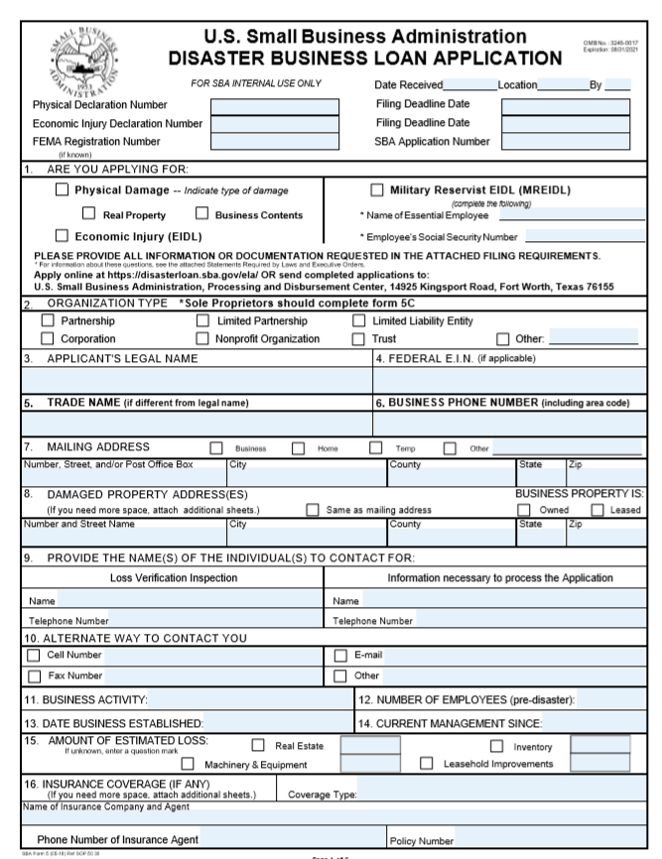
SBA’s Economic Injury Disaster Loans Filing Requirements
Completed SBA loan application (SBA Form 5).
Tax Information Authorization (IRS Form 4506T)
for the applicant, principals and affiliates.
Complete copies of the most recent Federal Income Tax Return.
Schedule of Liabilities (SBA Form 2202).
Personal Financial Statement (SBA Form 413).
Other Information may also be requested.
*Although a paper application and forms are acceptable, filing electronically is easier, faster and more accurate.
8-12-20
14
Notes:
The application process will require some quality preparation time and most applicants will benefit from discussing their application with an SBA representative or one of our resource partners, such as the SBDC. The information we require is generally the same type of information any prudent lender would require.
A loan package consists of an SBA loan application and several supporting documents. The forms are available online or in a package SBA can send you.
Most people can complete the application (SBA Form 5) in about 30 minutes.
A Tax Information Authorization (IRS Form 4506 T) is required from the applicant, owners and affiliates. This provides SBA access to your tax transcripts and is our primary documentation of repayment ability and eligibility. You can complete an 4506T1 in 5 minutes or less.
The applicant must provide its last 3 federal income tax returns, including all schedules, if available.
A schedule of liabilities (SBA Form 2202 may be used) is required from the applicant and all affiliates. This is a listing of your notes mortgages and accounts payable. It is a supplement to your balance sheet and provides terms and other relevant information necessary to process your application.
All principals must provide a Personal Financial Statement (SBA Form 413). Generally, a principal is anyone who owns 20% or more of the business. This form is similar to statements required by private lenders.

Slide 15
SBA’s Economic Injury Disaster Loans Filing Requirements
8-12-20
15

Slide 16
SBA’s Economic Injury Disaster Loans Filing Requirements
Complete an SBA disaster business loan application (SBA Form 5).
*Although a paper application and forms are acceptable, filing electronically is easier, faster and more accurate.
8-12-20
16
Notes:
The application process will require some quality preparation time and most applicants will benefit from discussing their application with an SBA representative or one of our resource partners, such as the SBDC. The information we require is generally the same type of information any prudent lender would require.
A loan package consists of an SBA loan application and several supporting documents. The forms are available online or in a package SBA can send you.
Most people can complete the application (SBA Form 5) in about 30 minutes.

Slide 17
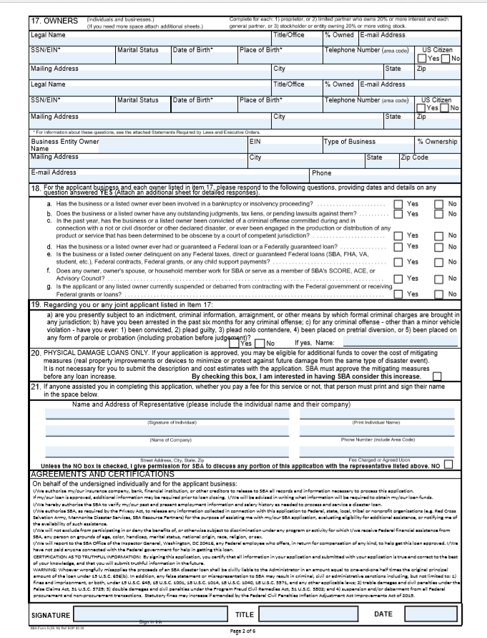
Filing Requirements- Back Side of the Application
SBA’s Economic Injury Disaster Loans Filing Requirements
Complete the SBA loan application (SBA Form 5).
*Although a paper application and forms are acceptable, filing electronically is easier, faster and more accurate.
8-12-20
17

Slide 18
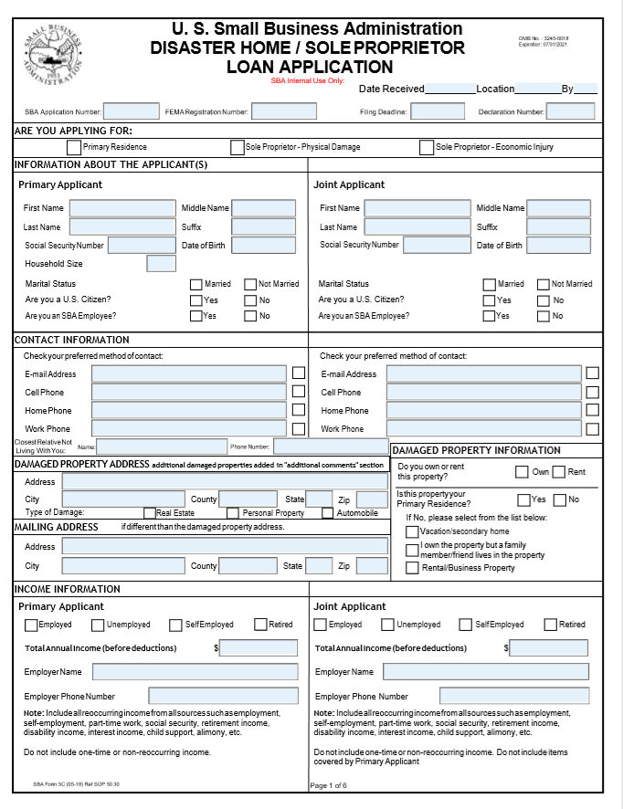
SBA’s Economic Injury Disaster Loans Loan Application Option
Sole proprietors can complete and SBA loan application (SBA Form 5-C).
*Although a paper application and forms are acceptable, filing electronically is easier, faster and more accurate.
8-12-20
18

Slide 19
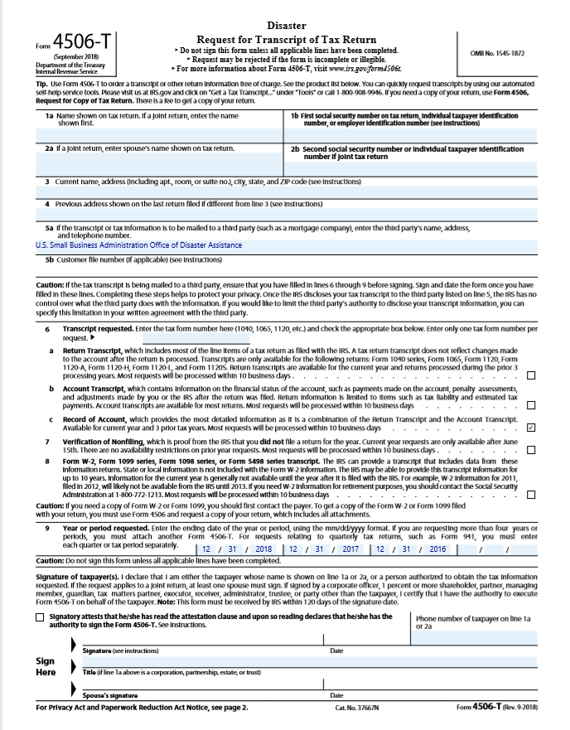
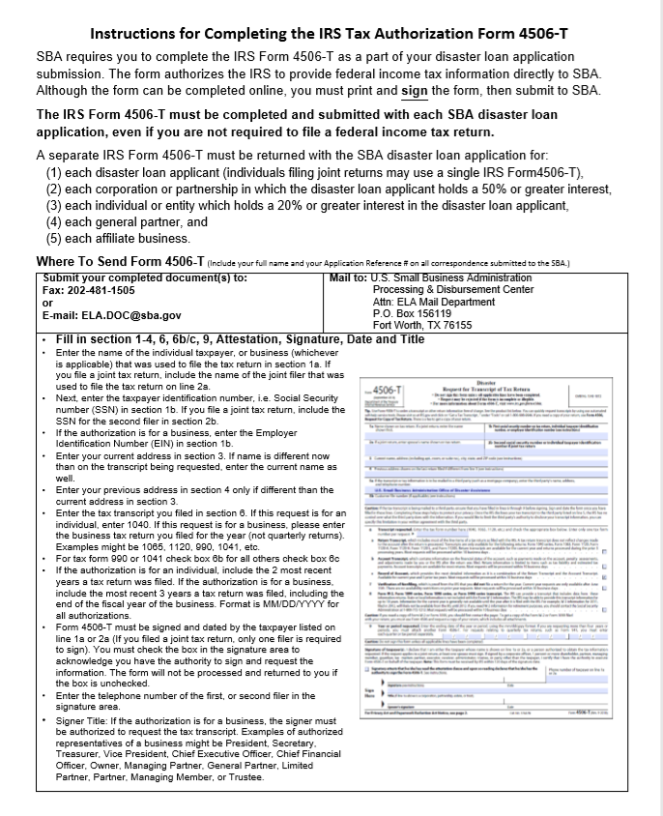
Filing Requirements IRS Form 4506-T
8-12-20
19
Notes:
A Tax Information Authorization (IRS Form 4506 T) is required from the applicant, owners and affiliates. This provides SBA access to your tax transcripts and is our primary documentation of repayment ability and eligibility. You can complete an 4506-T in about 5 minutes or less.
The applicant must provide its last federal income tax returns, including all schedules, if available.

Slide 20
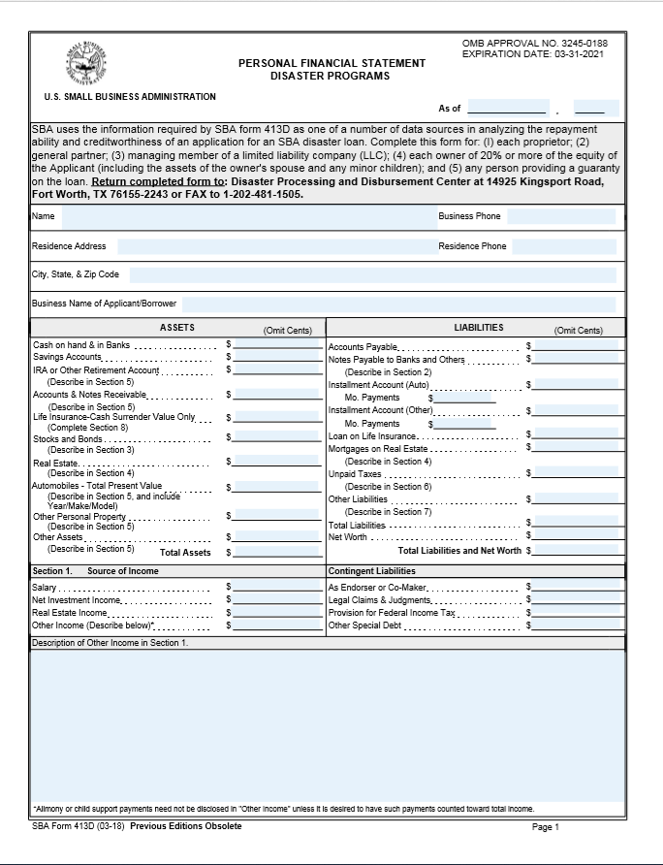
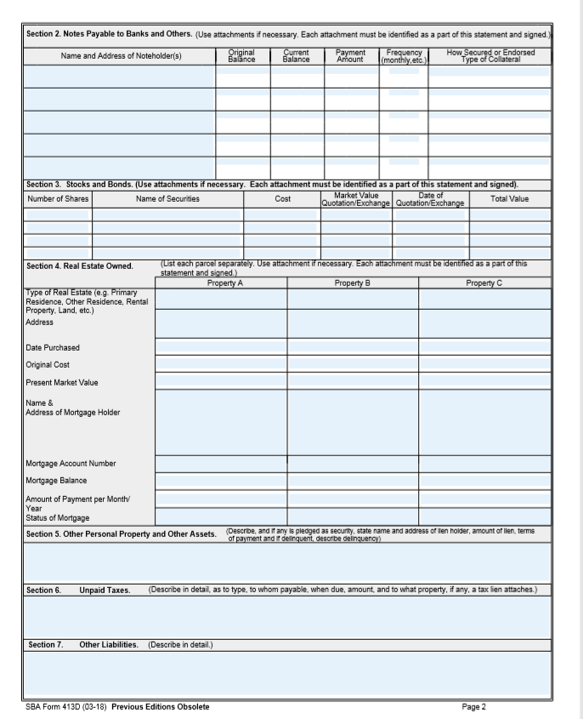
Filing Requirements-Personal Financial Stmt.
8-12-20
20

Slide 21
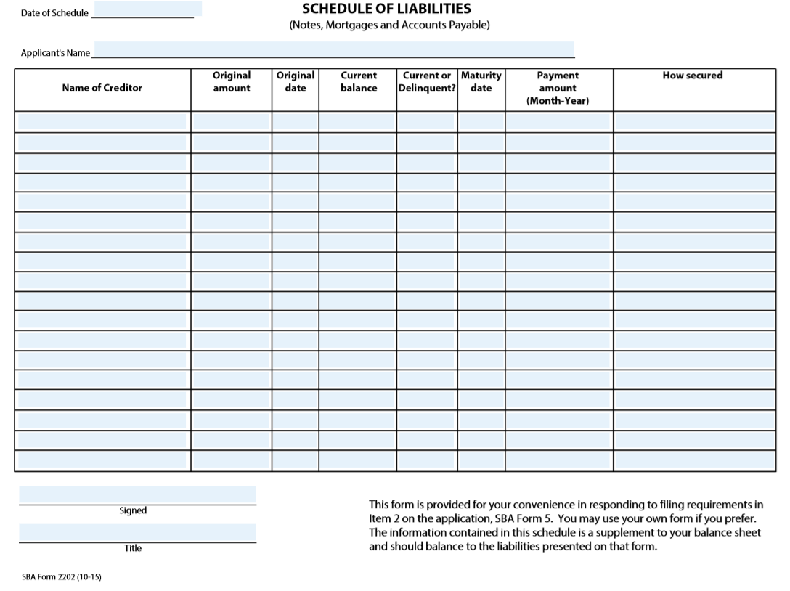
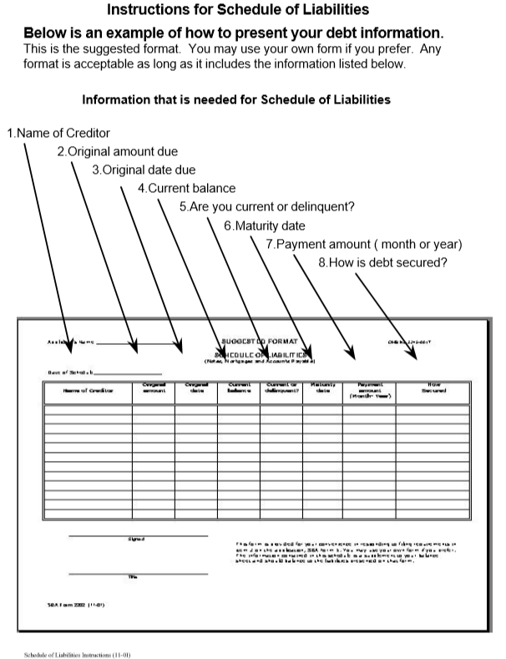
Filing Requirements –Schedule of Liabilities
8-12-20
21

Slide 22
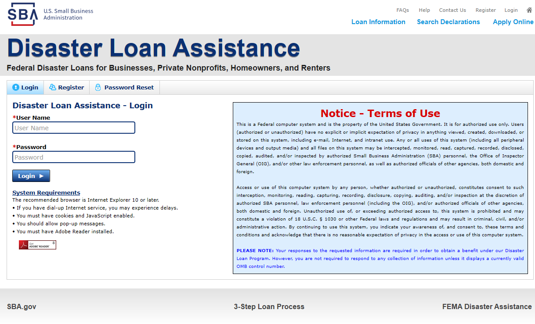
Additional Filing Requirements
Other information that may be requested:
Complete copy, including all schedules, of the most recent Federal income tax return for principals, general partners or managing member, and affiliates (see filing requirements for more information).
If the most recent Federal income tax return has not been filed, a year-end profit-and-loss statement and balance sheet for that tax year.
A current year-to-date profit-and-loss statement.
Additional Filing Requirements (SBA Form 1368) providing monthly sales figures. (This is especially important for Economic Injury Disaster Loans.)
8-12-20
22

Slide 23
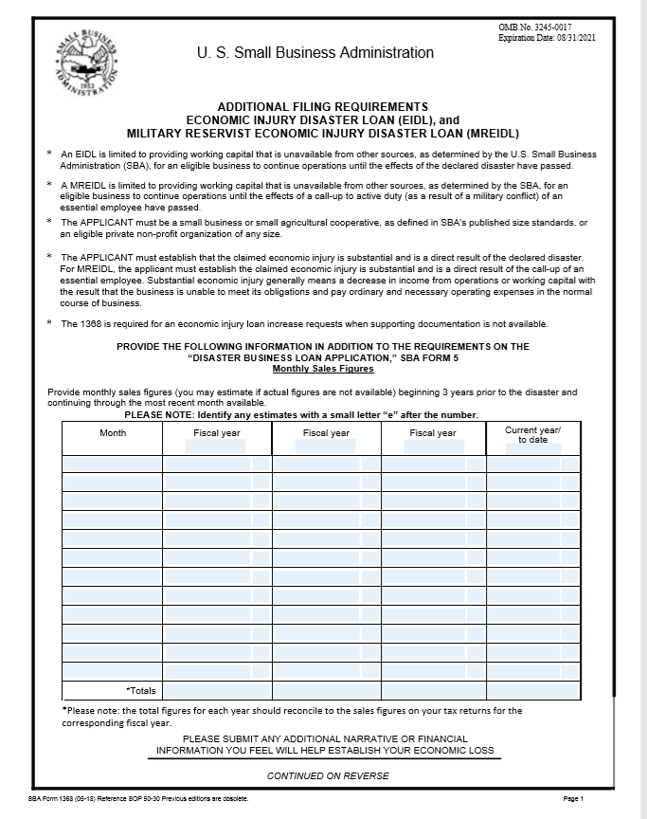
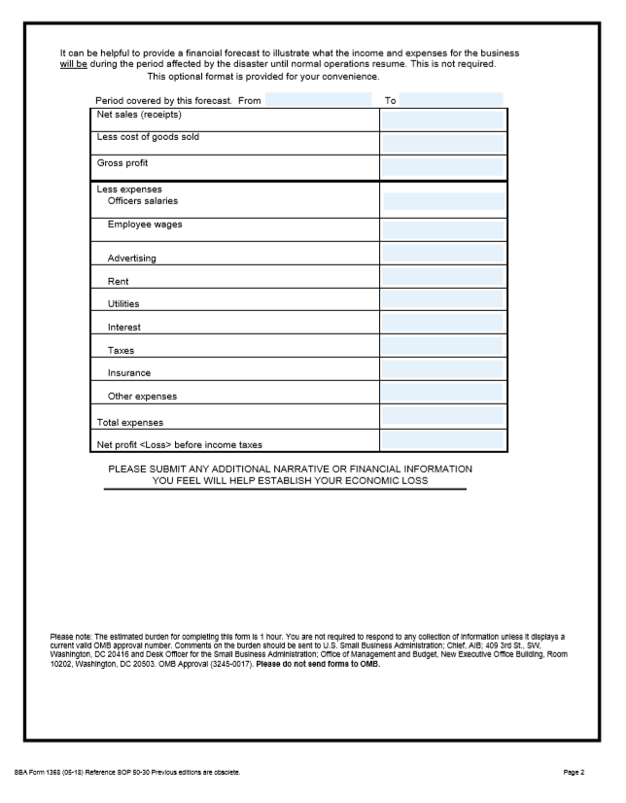
Filing Requirements for Economic Injury Disaster Loans- Monthly Sales, SBA Form 1368
8-12-20
23

Slide 24
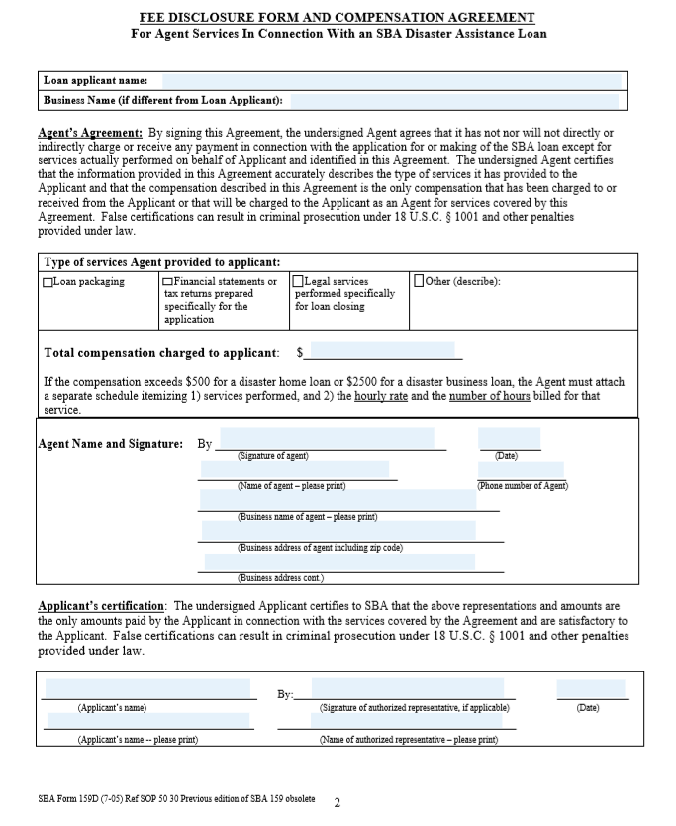
Filing Requirements Compensation Form
This form is only needed if you pay someone to help you complete the loan application or pay someone to help you close your loan and it costs in excess of $500 for a home loan application, or in excess of $2,500.
8-12-20
24

Slide 25
SBA’s Economic Injury Disaster Loans Types of Ineligible Entities
What are some of the businesses that are ineligible for an Economic Injury Disaster Loan?
Agricultural Enterprises -If the primary activity of the business (including its affiliates) is as defined in Section 18(b)(1) of the Small Business Act, neither the business nor its affiliates are eligible for EIDL assistance.
Religious Organizations
Charitable Organizations
Gambling Concerns (Ex: Concerns that derive more that 1/3 of their annual gross revenue from legal gambling activities)
Casinos & Racetracks (Ex: Businesses whose purpose for being is gambling (e.g., casinos, racetracks, poker parlors, etc.) are not eligible for EIDL assistance regardless of 1/3 criteria above.
8-12-20
25

Slide 26
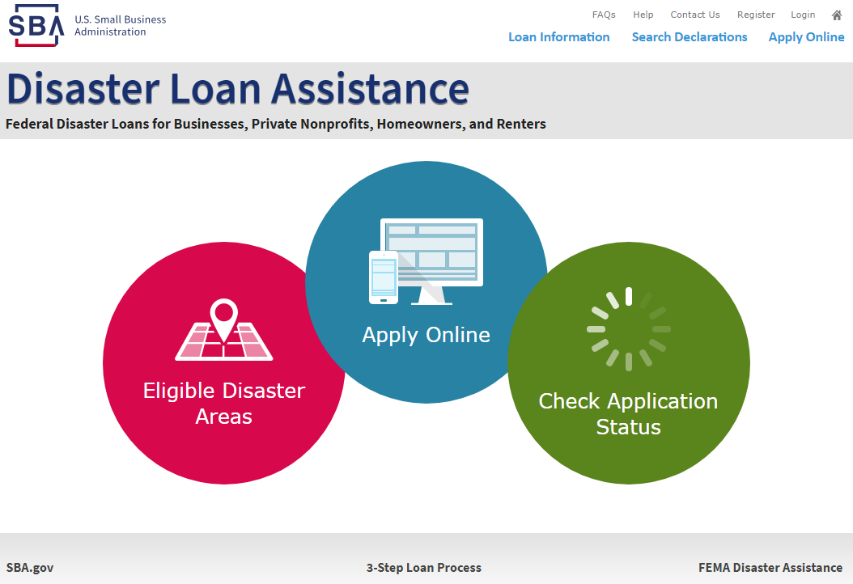
Apply Online at the SBA Disaster Loan Assistance Portal (DLAP)
https://disasterloan.sba.gov/ela
8-12-20

Slide 27
Apply by Mailing a completed application to:
U.S. Small Business Administration
Processing and Disbursement Center
14925 Kingsport Road
Fort Worth, Texas, 76155-2243
8-12-20

Slide 28
Apply by Mailing a completed application to:
U.S. Small Business Administration
Processing and Disbursement Center
14925 Kingsport Road
Fort Worth, Texas, 76155-2243
8-12-20

Slide 29
Apply by Mailing a completed application to:
U.S. Small Business Administration
Processing and Disbursement Center
14925 Kingsport Road
Fort Worth, Texas, 76155-2243
8-12-20

Slide 30
SBA Resource Partners
SBA’s Resource Partners help businesses:
Successfully stay in business.
Develop operational, financial and marketing plans.
Consider alternative sources of revenue.
Identify ways to reduce costs.
Update management and technical services
For the nearest office, visit: https://www.sba.gov/local-assistance
8-12-20

Slide 31
Submit The Application As Soon As Possible
Although the deadline to return the SBA physical loan application is not until October 2, 2020 and the SBA economic Injury Disaster Loan application deadline is not until May 3, 2021, encourage everyone to submit the completed application as soon as possible.
The biggest reason for delays in processing is due to missing information. Make sure to complete all filing requirements before submitting the application and forms.
If more funds are needed, applicants can submit supporting documents and a request for an increase. If less funds are needed, applicants can request a reduction in the loan amount.
If the loan request is denied, the applicant will be given up to six months in which to provide new information and submit a written request for reconsideration.
8-12-20

Slide 32
SBA Office of Disaster Assistance Contacts for the Public
For More Information about SBA disaster assistance programs, go to:
www.sba.gov/disaster
Or, contact SBA’s
Customer Service Center at:
1-800-659-2955 / 1-800-877-8339 (TTY)
Or by email at:
disastercustomerservice@sba.gov
8-12-20
32

Slide 33
Any Questions?
For information on the Small Business Administration
and its programs visit our website at:
www.sba.gov/disaster
8-12-20

